Slide 1
New Pedagogies for Science Teaching
PER Techniques
O
A
P
T
Evidence-Based Teaching Methods
John Caranci
STAO 2013

Slide 2
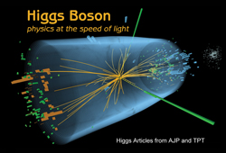
Birth of PER
At the University of Arizona in early 70's a physics professor found when problems in assessments relied only on concepts without the mathematics students did very poorly. This was the birth of Physics Education Research.

Slide 3
How Different
PER is researched based. The methods and pedagogies are not anecdotal. They are evidence-based teaching methods.
There is a full research procedure to show the efficacy of the methods.
Few Faculties of Education research on physics concept attainment and may do not research concept attainment in the sciences.

Slide 4
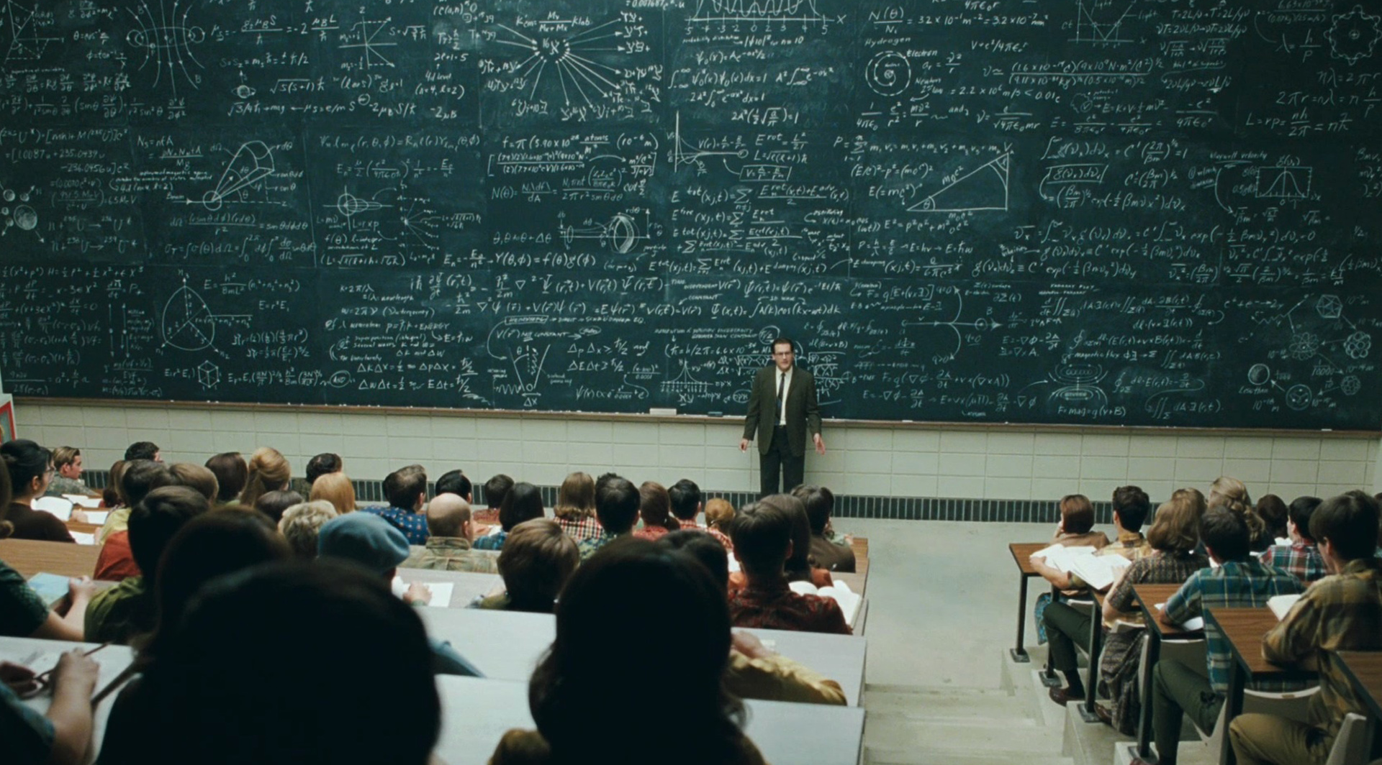
This is a Lecture?

Slide 5
The Lecture….
Physicists Seek To Lose The Lecture As Teaching Tool, Emily Hanford, National Public Radio, January 01, 2012
Is the Lecture Dead? Richard Gunderman, The Atlantic, Jan 29 2013,
Twilight of the Lecture, Harvard Magazine, November-December 2013
The Death of the Lecture Michael Abrams, ASME.org, September 2012

Slide 6
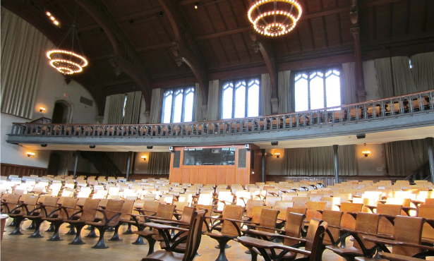
Our Quiet Future!

Slide 7
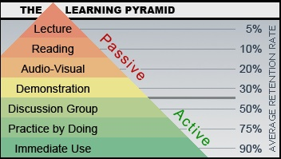

Slide 8
What Counts
It is not what the teacher does that counts – it is what the teacher gets the students to do.
“WHO DOES THE WORK DOES THE LEARNING!”

Slide 9
Where Do We Look?
The Parable of the Lamplight
When you arrive home from a walk one very dark night you notice your keys are missing. Where would you look for them? You would look under the street lamp, because you would not find them in the dark otherwise.

Slide 10
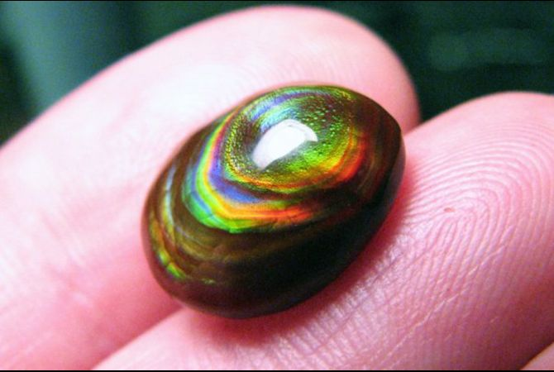
And Sometimes…
When you are strolling down the beach
You Find:
A Shinny Pebble

Slide 11
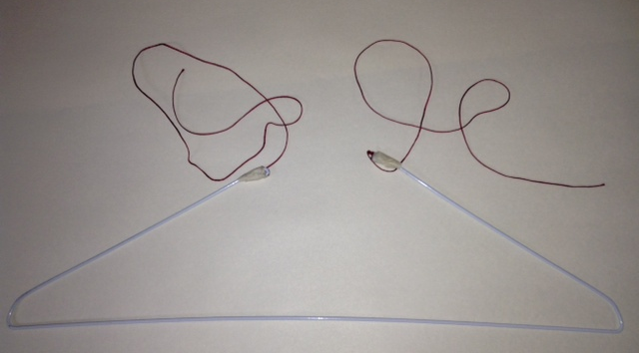
Nature of Science
One person at the table pick up the hanger and put the strings to the tragus then hit object with it.
Remaining people at the table describe their observations on the white board.

Slide 12
Whiteboard Technique
Using dry erase white boards of personal size to indicate answers and results of deliberations.
Use requires everyone to respond and therefor engage
Psychological confidence indicated by body attitude and height of board.
Teacher can easily survey class results

Slide 13
Keys
Level – All science
Teacher Effort – low
Needs – Dry erase personal sized boards
Uses - mathematical understanding, Problem-solving skills, relating to the real world, Think like a scientist, Reflecting on one's own learning, Self-confidence, Representing knowledge in multiple ways

Slide 14
First Law of Learning
Those doing the work - do the learning
If the teacher is talking the teacher is working therefore learning
What individuals and groups do informs their learning and what they learn.

Slide 15
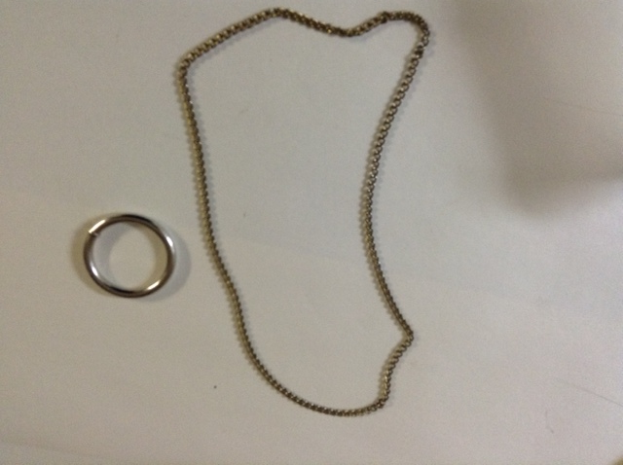
Ring and Chain Activity
Observe the ring and chain interaction.
Group discussion – How/why does this happen?

Slide 16
Using Your ABCD Cards
The ring has an opening letting the chain through.
Through slight of hand the chain is tied a different ring. The second ring is in John’s hand.
The ring flips and sweeps up the chain.
The human eye is too slow to catch the movement.

Slide 17
Teaching with Clickers
Clickers are electronic devices that allow students to vote on multiple-choice questions and teachers to collect and display the results of voting instantaneously. It also requires full engagement by students. It enhances collaboration leading to better learning. Clickers are not really a teaching method, but a technology that can be used as a part of many different teaching methods, including Peer Instruction, TEFA, and Think-Pair-Share (see similar methods), etc. Can be substituted with inexpensive ABCD cards.

Slide 18
Keys
Level – Any Science
Teacher Effort – Low
Needs – ABCD cards or clickers (with supporting software)
Uses - Conceptual understanding of science content
Can be adapted for: Problem-solving skills, Connecting conceptual and mathematical understanding, Coherent framework for science, Understanding how science relates to the real world, Think like a scientist, Reflecting on one's own learning, Self-confidence around science, Enjoyment of science, Representing knowledge in multiple ways

Slide 19
The Infinite Cheese
Solve the following problem using any method you think appropriate.
Imagine an infinite cheese. Imagine an infinitely large knife. When the knife cuts once there are then two infinite pieces. With two cuts there is four pieces. With three cuts there is eight pieces. The cuts are not parallel, not perpendicular, and no three cuts are along the same line, so, the forth cut provides a finite size piece that is bordered by the cuts. How many pieces are there after five cuts and after six cuts? (Bonus: Find the general formula where n, would be the number of cuts and p, the number of pieces)

Slide 20
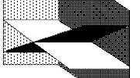
Use the White Boards

Slide 21
But Come to a Consensus – You Must Agree
Hold Up Your Boards

Slide 22
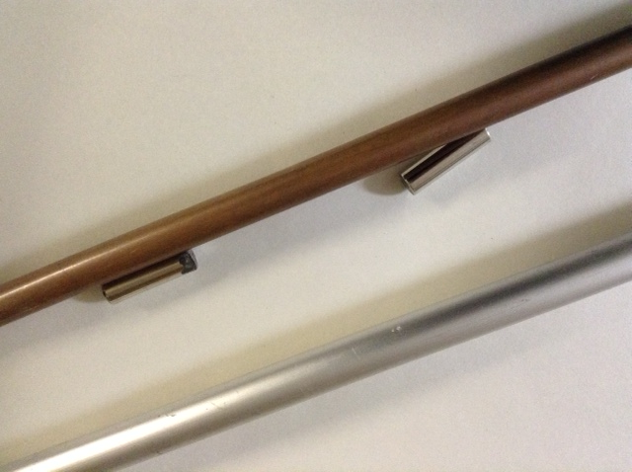
Field Problem
Tube and Magnet
Why does the magnet slow down in the tube or does it?

Slide 23
But Come to a Consensus – You Must Agree
Hold Up Your Boards

Slide 24
Which Problem is More Difficult?
Using your ABCD cards
The first problem
The second problem
Both equal difficulty
What problem?

Slide 25
Ranking Task Exercises
Exercises that require students to engage in a comparison reasoning process: students rank variations of phenomenological situations on the basis of a specified quantity or quality and explain their reasoning. Ranking Tasks frequently elicit students' natural ideas about the behavior of systems rather than a memorized response, providing teachers with a way to gain important insights into students' thinking.

Slide 26
Keys
Level – Junior and Senior Mathematics and Sciences
Teacher Effort – low
Needs – Sources for tasks
Uses - Conceptual understanding of content

Slide 27
Tears of the Surgeon
A surgeon attends a conference where they learn a new procedure that will improve survivability by 80%. When they go back to their home clinic they arbitrarily decide to keep doing the old method. Is this grounds for malpractice?
Glenn Wagner (OAPT)

Slide 28
What About Lecture?
Save a drowning man and/but tie your shoelaces.
Walden by Henry David Thoreau
Notes:
Not a precise quote but the meaning remains.

Slide 29
"We are all apprentices of a craft where no one ever becomes a master."
- Ernest Hemingway (1961)

Slide 30
Just-in-Time Teaching (JiTT)
Students are asked questions, usually online, which both encourage preparation for the class and encourage students to come to class with a "need to know.” Students respond online. Teachers use the responses to fine tune their presentation, and incorporate quotes from the student responses into the class.

Slide 31
Keys
Level – All Subjects (not just Sciences)
Teacher Effort – Medium/high
Needs – Student home computers, online management and collection tools for online responses
Uses - Conceptual understanding of science content , Connecting conceptual and mathematical understanding, Coherent framework for science, Understanding how science relates to the real world, Think like a scientist, Representing knowledge in multiple ways, Study skills Can be adapted for: Reflecting on one's own learning, Self-confidence around science, Enjoyment of science, Autonomy

Slide 32
Interactive Class Demonstrations
Active-learning worksheets designed to be used in large class environments. Students make predictions about the outcomes of science demonstrations using microcomputer-based laboratory equipment (probes), or physical demonstrations discuss their predictions in small groups, observe the results of the live demonstration, compare these results with their predictions, and attempt to explain the observed phenomena.

Slide 33
Keys
Level – Secondary Science
Teacher Effort – low
Needs – Laboratory equipment for teacher/students to do demonstrations
Uses - Conceptual understanding of content , Connecting conceptual and mathematical understanding, Representing knowledge in multiple ways

Slide 34
Interactive Simulations
PhET, Gizmos, and other simulations provide interactive, game-like environments which enable scientist-like exploration, connect to the real world, and include key visual models that experts use by, for example, making the invisible visible and providing multiple representations. Choosing ones with intuitive interface and minimal text, designed to give teachers control over how they are used in the classroom. Many are available for free!

Slide 35
Keys
Level – junior and senior sciences
Teacher Effort – low
Needs – Internet connection, computers, flash, shockwave
Uses - conceptual understanding, coherence, observation, Problem-solving skills, Designing experiments

Slide 36
Peer Instruction
Interactive engagement in classes by replacing lectures with small group discussions of conceptual questions, followed by whole-class discussions.
Students first think about and answer these questions individually; then discuss the explanations for their answers with their neighbors and come to agreement on the underlying .

Slide 37
Keys
Level – All science
Teacher Effort – low
Needs – ABCD cards or clickers (with supporting software)
Uses - Conceptual understanding of content, Connecting conceptual and mathematical understanding, Problem-solving skills, Enjoyment of science, Coherent framework for science, Understanding how science relates to the real world, Think like a scientist, Reflecting on one's own learning, Self-confidence around science, Representing knowledge in multiple ways

Slide 38
Cooperative Group Problem-Solving
Students work in small groups using structured problem-solving strategy to solve complex context-rich problems that are too difficult for any one student to solve individually.

Slide 39
Keys
Level – Secondary Science
Teacher Effort – Medium
Needs – Class restructuring, Large choice of multi-step problems
Uses - Problem-solving skills , Conceptual understanding of science content , Connecting conceptual and mathematical understanding, Understanding how science relates to the real world, Group work. Can be adapted for: Coherent framework for science, Think like a scientist, Self-confidence around science, Enjoyment of science, Representing knowledge in multiple ways

Slide 40
Context-Rich Problems
Students work in small groups on short realistic (authentic) scenarios giving them a plausible motivation for solving the problem. These should be more complex than traditional problems. Reflect the real world, and may include excess information, or require the student to recall important background information.

Slide 41
Keys
Level – All Sciences
Teacher Effort – Medium
Needs – Classroom Restructuring
Uses - Problem-solving skills , Conceptual understanding of science content , Connecting conceptual and mathematical understanding, Coherent framework for science Can be adapted for: Understanding how science relates to the real world, Think like a scientist

Slide 42
RealTime Science
RealTime science is a series of introductory laboratory modules that use computer data acquisition tools (microcomputer-based lab like probes) to help students develop science concepts and acquire laboratory skills. Besides data acquisition, computers are used for basic mathematical Modelling, data analysis, and simulations. Students construct their own models of phenomena based on observations and experiments.

Slide 43
Keys
Level – All Sciences
Teacher Effort – low
Needs – Computers for student use in class, Lab equipment for student use - professional, Cost for students, Tables arranged for group work or work stations.
Uses - Conceptual understanding of science content , Connecting conceptual and mathematical understanding, Laboratory skills, Representing knowledge in multiple ways.

Slide 44
Microcomputer-based Laboratories
Laboratory activities that collect and present data graphically in real time, allowing students to get a direct intuitive sense of fundamental science concepts that cannot be observed directly.

Slide 45
Keys
Level – All Sciences
Teacher Effort – Medium
Needs – Computers for student use in class, Lab equipment for student use – professional Skills, Probeware
Uses - Connecting conceptual and mathematical understanding, Think like a scientist, Enjoyment of science, Designing experiments Research

Slide 46
Workshop Science
Lessons and laboratories with sequenced activities. In a typical two-hour Workshop science class session, students work in groups of 3 or 4 to make and discuss predictions and then use equipment and computer tools for simple observations, data acquisition, visualization, analysis, and mathematical Modelling.

Slide 47
Keys
Level – All science
Teacher Effort – Medium
Needs – Student Assistants, Projector in class, Computers for student use in class, Lab equipment for student use, Tables arranged for group work
Uses - Conceptual understanding of science content , Connecting conceptual and mathematical understanding , Coherent framework for science, Self-confidence around science , Enjoyment of science , Laboratory skills , Representing knowledge in multiple ways , Designing experiments, Think like a scientist, Creativity, collaborative skills Can be adapted for: Autonomy , Problem-solving skills, Reflecting on one's own Learning

Slide 48
SCALE-UP
Student-Centered Active Learning Environment
An integrated learning environment in which the space is carefully designed to facilitate interactions between teams of students who work on short, interesting tasks. Students work in small groups around round tables on hands-on activities, questions, simulations, or laboratories. All course components are mixed together; there is no separate lab class and most of the classes are actually class-wide discussions.

Slide 49
Keys
Level – All Sciences, Teacher Preparation
Teacher Effort – high
Needs – Studio classroom exclusively designed for the class
Uses - Problem-solving skills , Conceptual understanding of science content , Reflecting on one's own learning , Self-confidence around science , Enjoyment of science , Laboratory skills , Representing knowledge in multiple ways , Designing experiments , Connecting conceptual and mathematical understanding, Coherent framework for science, Understanding how science relates to the real world, Think like a scientist, working in groups

Slide 50
Modelling Instruction
Modelling Instruction is a guided-inquiry interactive-engagement method of science teaching that organizes instruction around building, testing and applying the handful of scientific models that represent the content core of science. The conceptual coherence afforded by the Modelling Method corrects many weaknesses of the traditional lecture-demonstration methods, including fragmentation of knowledge, student passivity, and persistence of naive beliefs about the physical world.

Slide 51
Keys
Level – Senior Sciences
Teacher Effort – high, needs training and practice
Needs – Computers for student use in class, Lab equipment for student use – professional, Tables arranged for group work
Uses - Problem-solving skills , Conceptual understanding of science content , Connecting conceptual and mathematical understanding , Representing knowledge in multiple ways , Coherent framework for science, Think like a scientist, Reflecting on one's own learning, Self-confidence around science, Designing experiments Can be adapted for: Understanding how science relates to the real world, Enjoyment Can be adapted for: Understanding how science relates to the real world, Enjoyment of science, Laboratory skills, Creativity, Autonomy, scientific argumentation, scientific reasoning

Slide 52
Science by Inquiry
A laboratory-based guided-inquiry that helps students develop deep understanding of science content and scientific reasoning skills. Through in-depth study of simple physical systems and their interactions, students gain direct experience with the process of science. Starting from their own observations, they develop basic physical concepts, use and interpret different forms of scientific representations, and construct explanatory models with predictive capability.

Slide 53
Keys
Level – All Sciences and Teacher Preparation
Teacher Effort – high
Needs – Tables arranged for group work, Very well-trained teachers, minimal equipment for experiments
Uses - Conceptual understanding of science content , Connecting conceptual and mathematical understanding, Coherent framework for science, Understanding how science relates to the real world, Think like a scientist, Reflecting on one's own learning, Self-confidence around science, Representing knowledge in multiple ways, Designing experiments, Ability to teach by inquiry Research

Slide 54
Thinking Problems
A collection of homework problems, clicker questions, and exam questions, created for education researchers by the University of Maryland's Physics Education Research Group. Includes estimation problems, ranking tasks, and problems designed to help students connect mathematical and conceptual reasoning and relate science to the real world.

Slide 55
Keys
Level – Senior science
Teacher Effort – low/medium
Needs – Lab equipment, large catalogue of problems
Uses - Problem-solving skills, Conceptual understanding of science content, Connecting conceptual and mathematical understanding, Coherent framework for science, Understanding how science relates to the real world, Think like a scientist Can be adapted for: Reflecting on one's own learning, Self-confidence around science, Enjoyment of science

Slide 56
Workbook for Introductory Science
Carefully structured sequences of multiple-choice questions designed for use with classroom communication systems such as flash cards and clickers. Questions emphasize qualitative reasoning and multiple representations (graphs, diagrams, etc.), and are accompanied by notes, exams, and free-response worksheets designed for use in the environment of a large-enrollment class. The conceptual "step-size" from one question to the next is fairly small, ideal for students with less preparation.

Slide 57
Keys
Level – All subjects
Teacher Effort – medium
Needs – flash cards
Uses - Conceptual understanding of science content knowledge in multiple ways , Connecting conceptual and mathematical understanding Can be adapted for: Problem-solving skills, Reflecting on one's own learning, Self-confidence around science

Slide 58
Minds-On science
Minds-On science is an activity-based curriculum for high school science, helping students to explore basic concepts; hone and link concepts; develop analysis and reasoning skills; learn to apply concepts in problem-solving situations (and avoid rote procedures); and organize knowledge so that it is generally useful. A brief Student Reader summarizes ideas from groups of activities, about 1 page of reading per activity at the beginning of the year and 2 pages per activity at the end.

Slide 59
Keys
Level – All science
Teacher Effort – medium
Needs – Sources of readings, software organizational tools like flow charting and mind mapping
Uses - Problem-solving skills , Conceptual understanding of science content, Connecting conceptual and mathematical understanding , Coherent framework for science, Reflecting on one's own learning , Representing knowledge in multiple ways, Think like a scientist. Can be adapted for: Understanding how science relates to the real world, Self-confidence around science, Enjoyment of science, Laboratory skills, Designing experiments, Creativity, Autonomy

Slide 60
PRISMS PLUS
Science Physics Resources and Instructional Strategies for Motivating Students (PRISMS) PLUS is a high school science curriculum and professional development program that utilizes a learning cycle pedagogy. PRISMS PLUS utilizes high interest activities that integrates inexpensive and easily accessible materials with instructional technologies in an approach in which students are provided experiences to explore physical phenomena prior to being introduced to the science ideas related to the phenomena.

Slide 61
Keys
Level – All Sciences
Teacher Effort – medium
Needs – Computers for student use in class, Lab equipment for student use - professional, Lab equipment for student use
Uses - Problem-solving skills , Conceptual understanding of science content , Connecting conceptual and mathematical understanding , Understanding how science relates to the real world , Enjoyment of science

Slide 62
Student-Generated Scientific Inquiry
A curriculum for pre-service teachers that engages students in crafting and investigating their own scientific questions in topics that span the scientific disciplines. The course is modeled on a research lab, with students working on projects in small groups and sharing findings during whole-class "research-group" meetings. While students will learn a significant amount of content, the focus is on developing students' abilities to engage in open scientific inquiry.

Slide 63
Keys
Level – Grade 11 and 12 Sciences
Teacher Effort – high
Needs – high
Uses - Understanding how science relates to the real world a scientist, Enjoyment of science, Representing knowledge in multiple ways, Designing experiments, Creativity, Autonomy Can be adapted for: Conceptual understanding of science content, Coherent framework for science, Think like scientists

Slide 64
Additional Techniques 1
Activity-Based Tutorials, Volume 1: Introductory Pcience
Cae Think/Pair/Share
Cpu Computer Simulators
Cu Upper-Division Qm Curriculum
Diagnoser Tools
Energy Project
Explorations In science

Slide 65
Additional Techniques 2
Intermediate Mechanics Tutorials
Intuitive Quantum science
Investigative Science Learning Environment
Learning Assistant Program
Learning Physical Science
Lecture-Tutorials For Introductory Astronomy
Matter And Interactions

Slide 66
Additional Techniques 3
Modern science Curriculum
New Model Course In Applied Quantum science
Open Source science Collection
Open Source Tutorials
Paradigms In science
Peer Instruction For Quantum Mechanics
Physical Science And Everyday Thinking

Slide 67
Additional Techniques 4
science And Everyday Thinking
science Union Mathematics
Physlets
Quantum Interactive Learning Tutorials
Ranking Tasks For Introductory Astronomy
Scientific Community Laboratories
Socratic Dialog Inducing Laboratories
Tasks Inspired By science Education Research

Slide 68
Additional Techniques 5
Studio science
Technology-Enhanced Formative Assessment
Tools For Scientific Thinking
Tutorials
Tutorials In Introductory science
Tutorials In Thermal & Statistical science
Upper-Division E&M Curriculum

Slide 69
Websites for More
http://prst-per.aps.org/
http://www.compadre.org/per/
http://meyercreations.com/science/index.html
http://www.meyercreations.com/science/resources.html

